Slide 2
UNIT 3 Bayesian and instance based learning
Prefer BCA note for this chapter

Slide 3
Marginal probability
Marginal probability is the probability of an event irrespective of the outcome of another variable. It provides the probability of a single event happening without consideration of any other variables or conditions.
Example: the probability that a card drawn is red (p(red)=0.5). Another example: the probability that a card drawn is a 4 (p(four)=1/13
Given a set of random variables, the marginal probability of one of these variables is found by summing (or integrating) the joint probability distribution over the other variables.

Slide 4
Joint Probability
Joint probability is the probability of two or more events occurring simultaneously. It is a fundamental concept in probability theory that helps in understanding the relationship between multiple random variables.
The joint probability of two events A and B is denoted as P(A∩B) or P(A,B). It represents the likelihood that both events A and B occur at the same time.
For two random variables X and Y, the joint probability distribution P(X=x, Y=y) gives the probability that X takes the value x and Y takes the value y simultaneously.
Example: the probability that a card is a four and red = p(four and red) = 2/52 = 1/26. (there are two red fours in a deck of 52, the 4 of hearts and the 4 of diamonds).

Slide 5
The joint probability can be calculated using the conditional probability; for example:
P(A,B) = P(A/B)*P(B)
This is called the product rule. Importantly, the joint probability is symmetrical, meaning that:
P(A,B)=P(B,A)
Conditional Probability
The conditional probability is the probability of one event given the occurrence of another event, often described in terms of events A and B from two dependent random variables e.g. X and Y.
Probability of one (or more) event given the occurrence of another event e.g.
P(A given B)or P(A/B)
P(A/B) is the probability of event A occurring, given that event B occurs

Slide 6
Example: given that you drew a red card, what’s the probability that it’s a four
(p(four/red)) = 2/26 = 1/13. So out of the 26 red cards (given a red card), there are two four so 2/26 = 1/13.
The conditional probability can be calculated using the joint probability, for example:
P(A/B) = P(A,B)/P(B)
The conditional probability is not symmetrical; for example:
P(A/B)! = P(B/A)

Slide 7
Bayesian Belief networks
Bayesian Belief Networks (BBNs), also known as Bayesian Networks or Belief Networks, are graphical models that represent a set of variables and their probabilistic dependencies through a directed acyclic graph (DAG). They are powerful tools for modeling uncertainty and reasoning in complex domains, combining principles from graph theory and probability theory
Components of a Bayesian Belief Network
Nodes: Each node represents a random variable, which can be discrete or continuous.
Edges: Directed edges (arrows) between nodes represent conditional dependencies between the variables. An edge from node A to node B implies that A directly influences B.

Slide 8
Conditional Probability Tables (CPTs): Each node has an associated CPT that quantifies the effect of the parent nodes on the node. The CPT provides the probability distribution of the node given its parents.
Structure
A BBN is defined by two components:
Graph Structure: A directed acyclic graph where nodes represent variables and edges represent dependencies.
Parameters: Conditional probability distributions associated with each node, given its parents.

Slide 9
K-Nearest Neighbors Classifier
Algorithm
Decide the value of K
Calculate Euclidean distance between new example and examples in training set.
Take the K nearest neighbors
Among these k neighbors, count the number of the data points in each category/class.
Assign the new data points to that category for which the number of the neighbor is maximum.

Slide 10
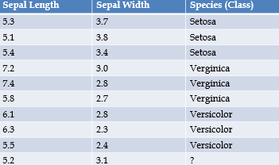
K-Nearest Neighbors Classifier
Example: Consider the following data points and find class label of last data point using KNN classifier.

Slide 11
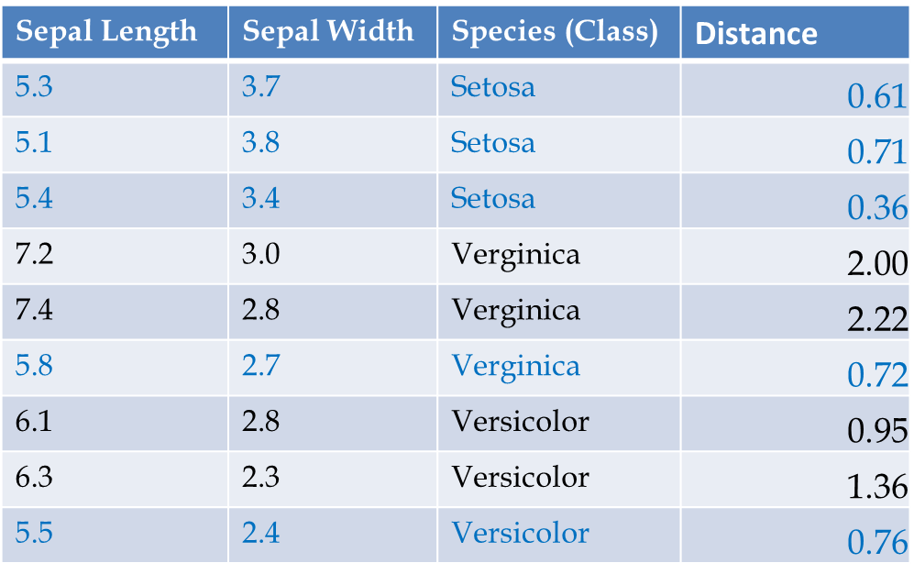
Solution: Distance between new data and training data is given below. Assume K=5.

Slide 12
From the table we can clearly see that out of 5 nearest neighbors votes are as below.
Setosa=3
Verginica=1
Versicolor=1
From this observation we can predict that the given data belongs to Setosa class.

Slide 13
Backpropagation algorithm
A popular method for the training of multilayer perceptrons is the back-propagation algorithm. The training proceeds in two phases:
Forward Phase: In this phase, the synaptic weights of the network are fixed and the input signal is propagated through the network, layer by layer, until it reaches the output. Thus, in this phase, changes are confined to the activation potentials and outputs of the neurons in the network.
Backward Phase: In this phase, an error signal is produced by comparing the output of the network with a desired response. The resulting error signal is propagated in backward direction through the network, again layer by layer. In this second phase, successive adjustments are made to the synaptic weights of the network

Slide 14
Algorithm
Initialize all weights and biases in network
While terminating condition is not satisfied
for each training tuple X in D
for each input layer unit j: y_{j} = x_{j}; // output of an input unit is its actual input value
for each hidden or output layer unit j
compute the net input of unit j with respect to the previous
layer,
compute the output of each unit j

Slide 15
for each unit j in the output layer
for each unit j in the hidden layers, from the last to the first hidden layer
for each weight w_{ji} in network
//Weight Update

Slide 16
backpropagation
Backpropagation algorithm needs to compute
to compute . This depends upon choice of activation function.
Case I: Logistic Activation Function
If we consider general sigmoid function, then
Note: Compute Derivatives of Logistic activation function.

Slide 17
Case II: Hyperbolic Tangent Function
If we consider general Tanh function, then

Slide 18
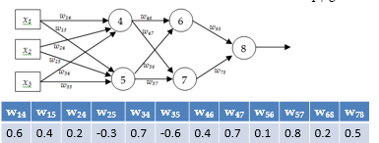
Example
Consider a MLP given below. Let the learning rate be 1. The initial weights of the network are given in the table below. Assume that first training tuple is (1, 0, 1) and its target output is 1. Calculate weight updates by using back-propagation algorithm. Assume .

Slide 19
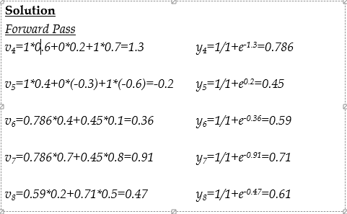

Slide 20
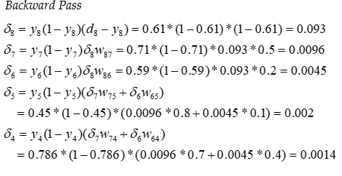

Slide 21
